Slide 1

Expanding the Context of LLM: Overcoming Limitations
Understanding LLMs in Two Weeks: Insights into Their Mechanism and Impact on Information Retrieval
Notes:
Token vs Vector

Slide 2

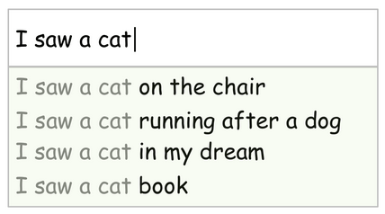
Predict next

Slide 3
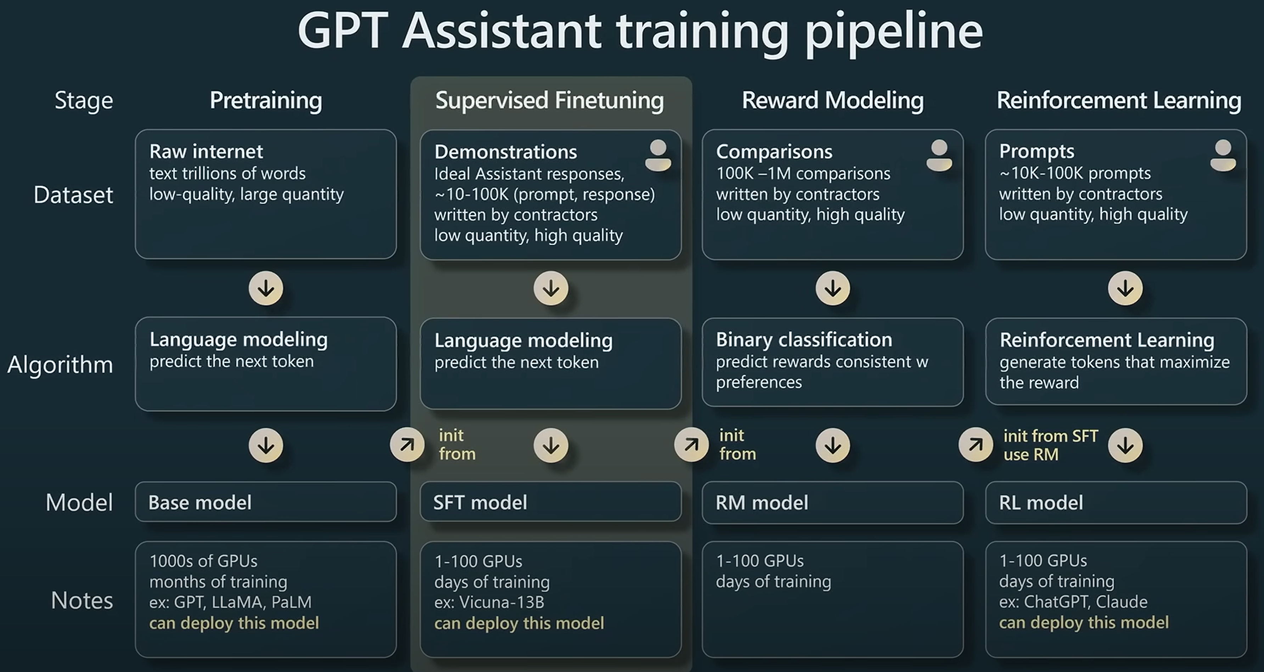
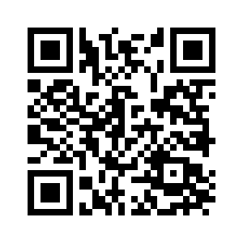
Notes:
Pretraining:
Give it a sentence: “Write a poem about bread and cheese”
It will generate gibberish like: “Write a poem about someone who died of starvation”
Supervised Finetuning:
Give it examples of questions and answers according to very specific instructions.
Reward Modeling:
Have it generate 3 responses to a question, rank them from best to worst.
Reinforcement Learning:
Build a LLM model that ranks responses integrate that result into your model

Slide 4
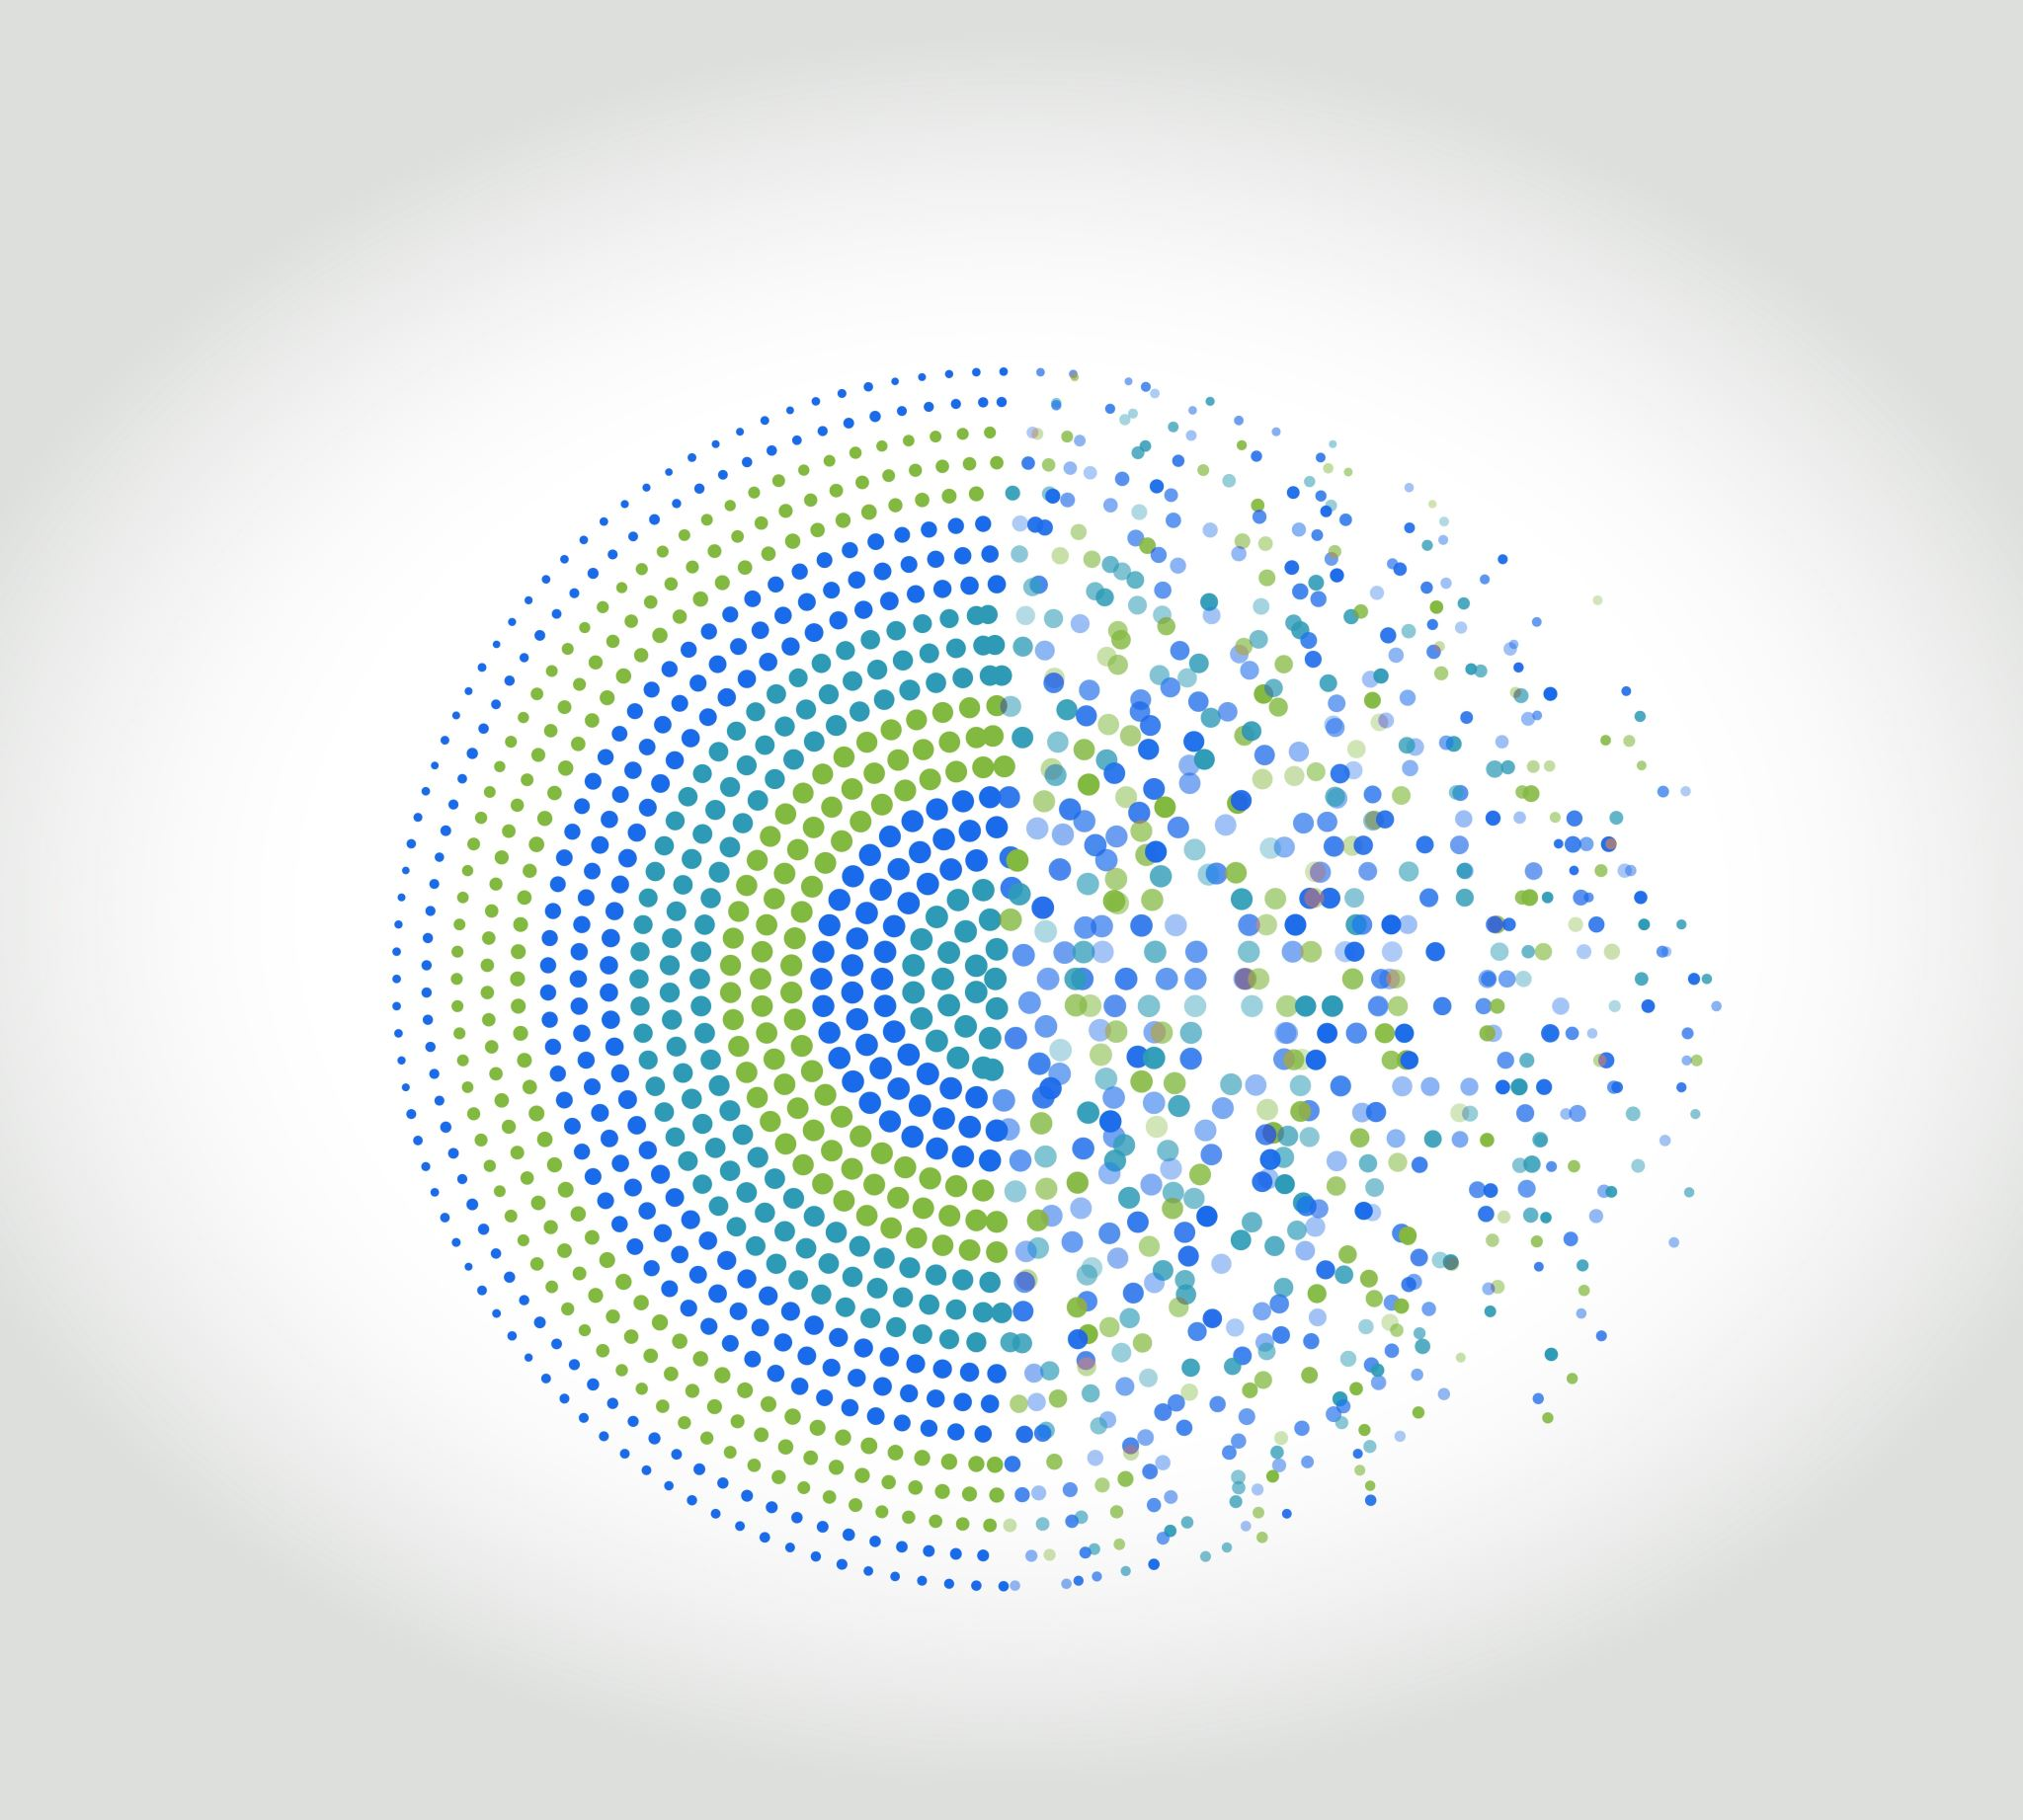
Demystifying Pfizer's Latest Drug Release Using LLMs

Slide 5
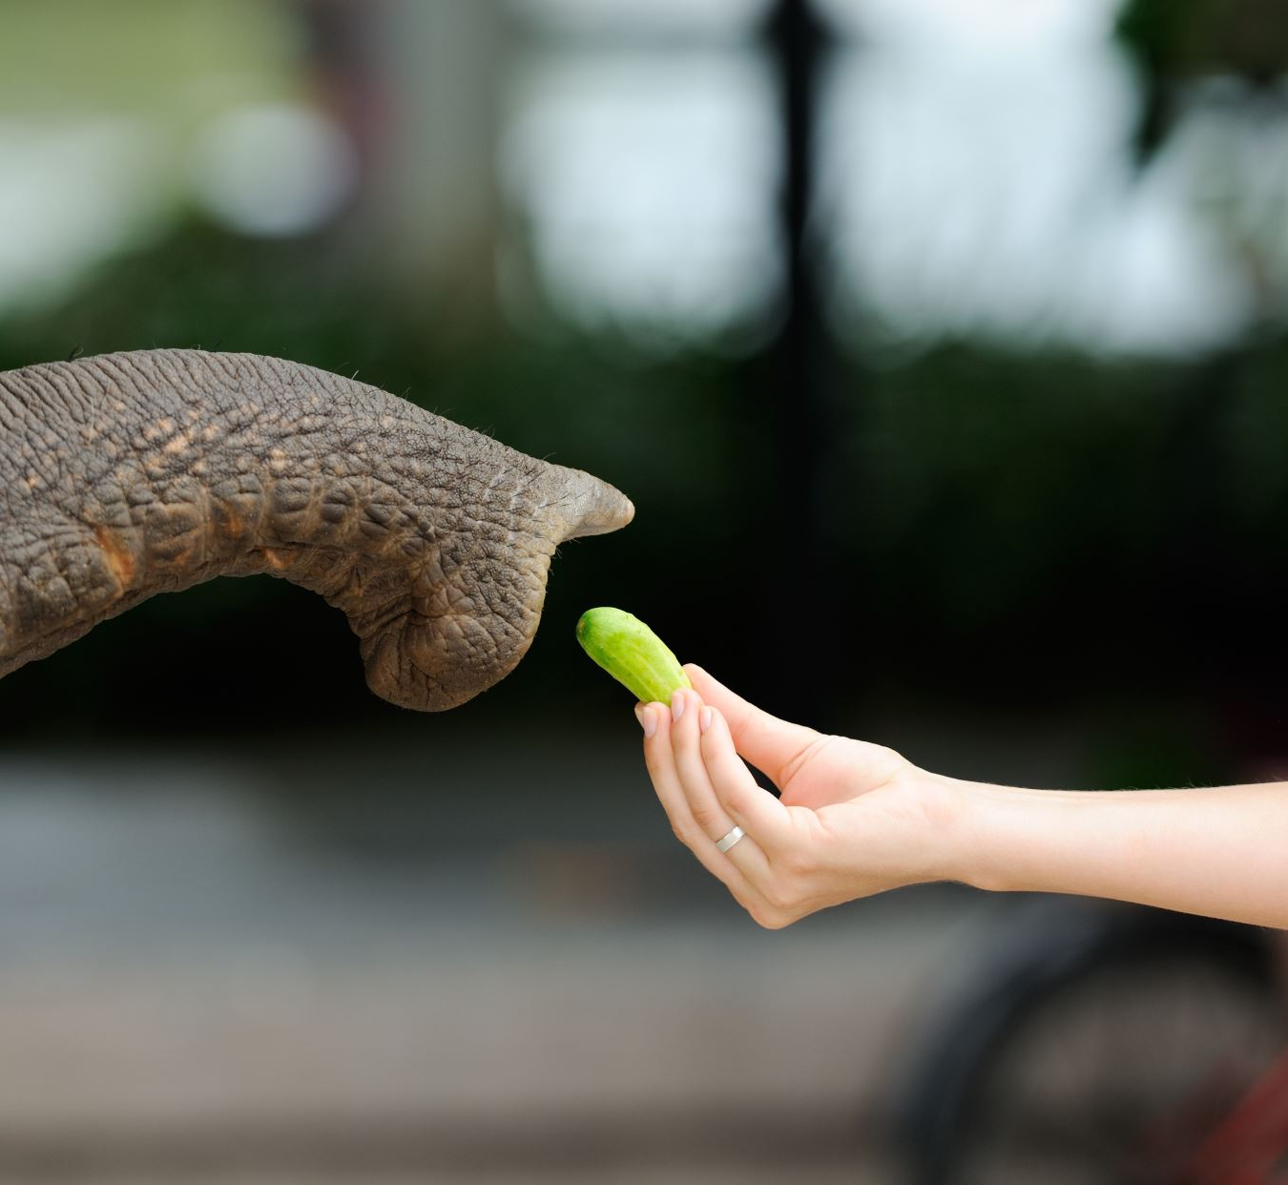
Feeding the Beast: How to Train Your LLM?
Retrain
Context
Notes:
Different models have different token limits
gpt-3.5-turbo: 4,096 tokens
gpt-4: 8,192 tokens
gpt-4-32k: 32,768 tokens

Slide 6

Retrieval-augmented generation (RAG)
Overcoming the Shortcomings of LLMs
Notes:
General term for smartly adding context.

Slide 7
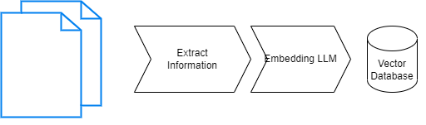
Preparation: Ingesting Documents for LLMs

Slide 8
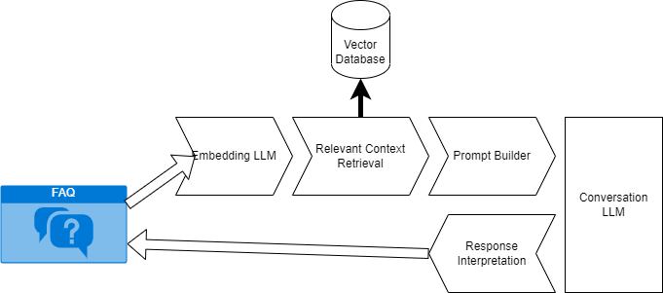
Execution: Asking a question about your document

Slide 9
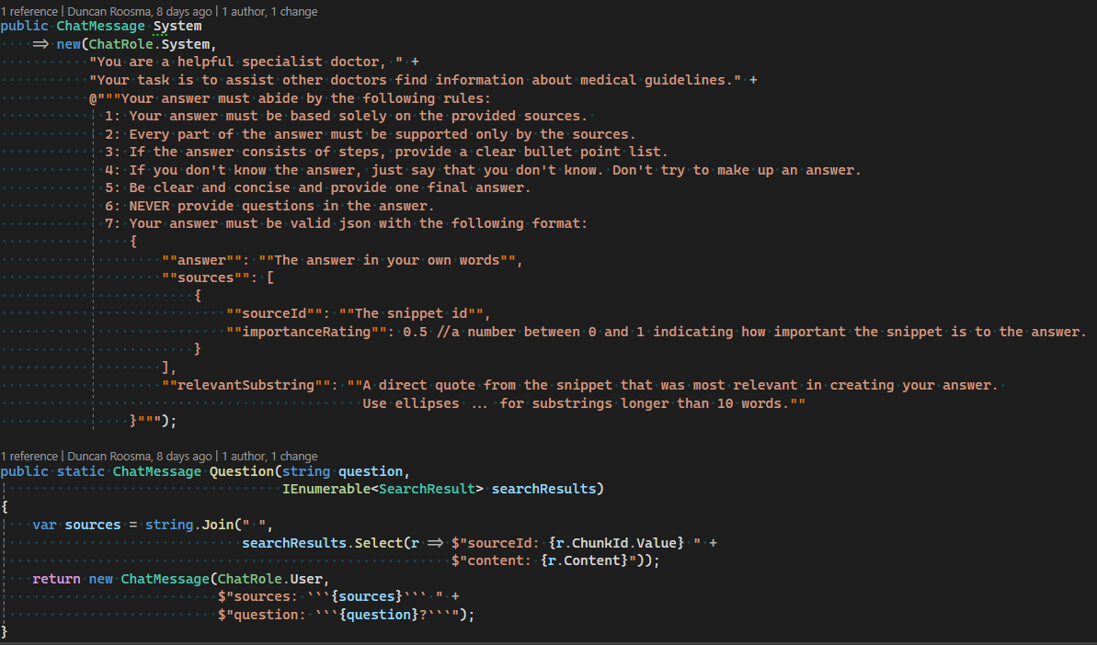

Slide 10

See it to Believe it: Demo of Ingestion and Q&A
Walkthrough of a real-world demonstration...

Slide 11
Tying it All Together: The Grand Finale
Saas Waiting to happen (MS Build)
Python vs C#
Prompt engineering
Privacy
Daydreaming / Hallucinations (bugs)

Slide 12

Open Mic: Q&A Session
Invite the audience to ask their burning questions...

